Slide 1

Think Like an Attacker: Why Your npm install Is a Hacker’s Dream
Sudhanshu Dasgupta
Software Engineer, SafeDep

Slide 2
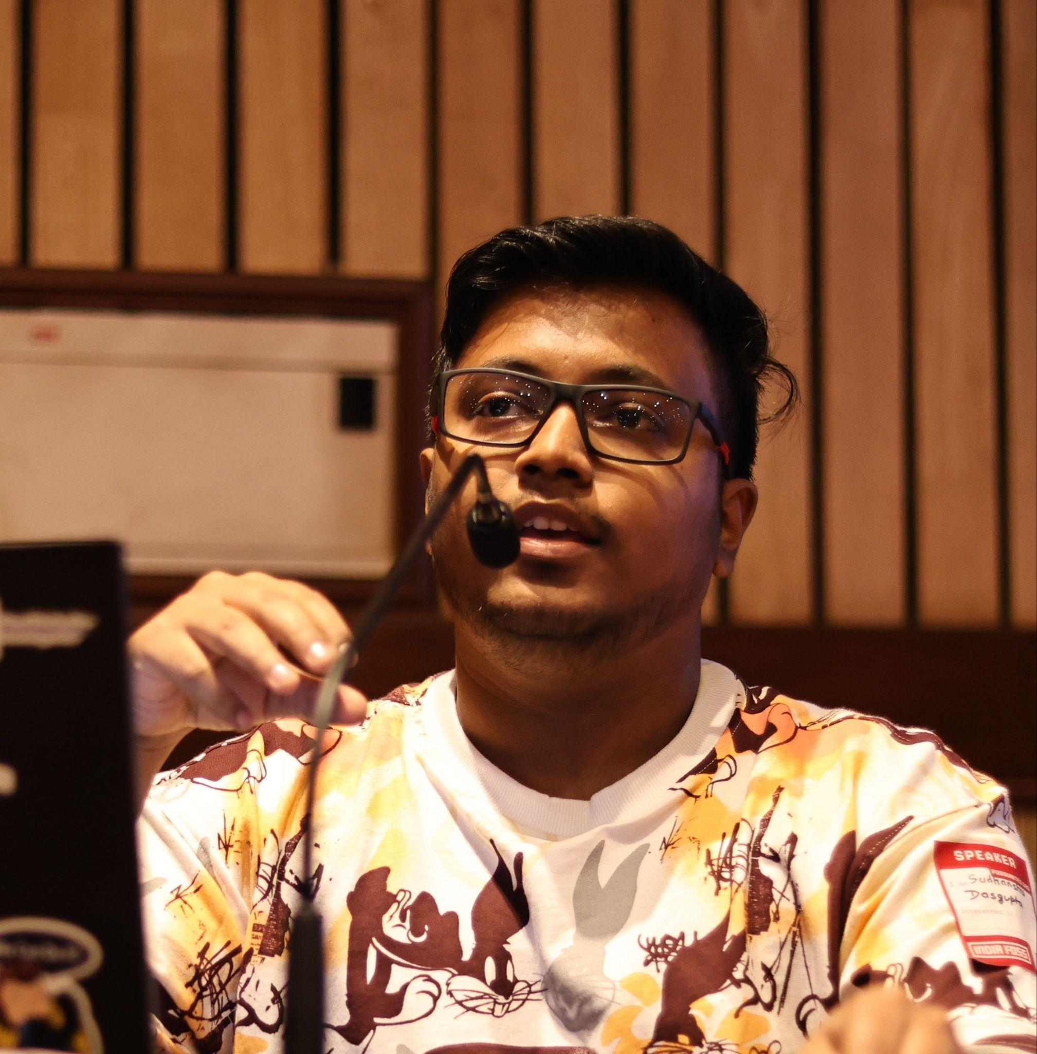


Sudhanshu Dasgupta
Software Engineer, SafeDep
SudhanshuDasgu3
sudhanshu-dasgupta

Slide 3
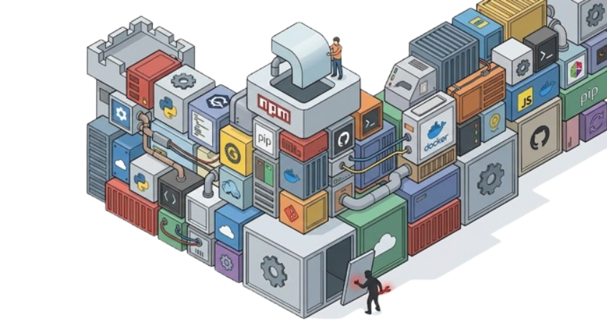
90% of your codebase isn't yours.
It's open source packages you installed.

Slide 4
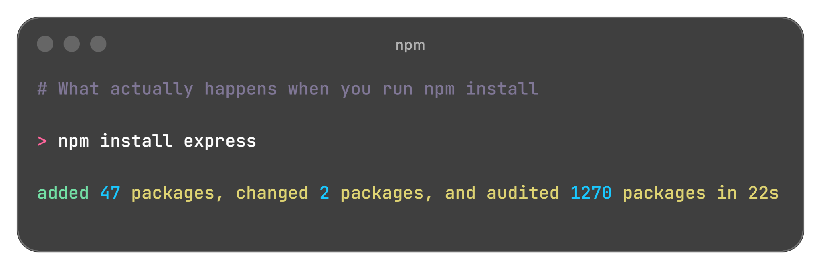

Slide 5
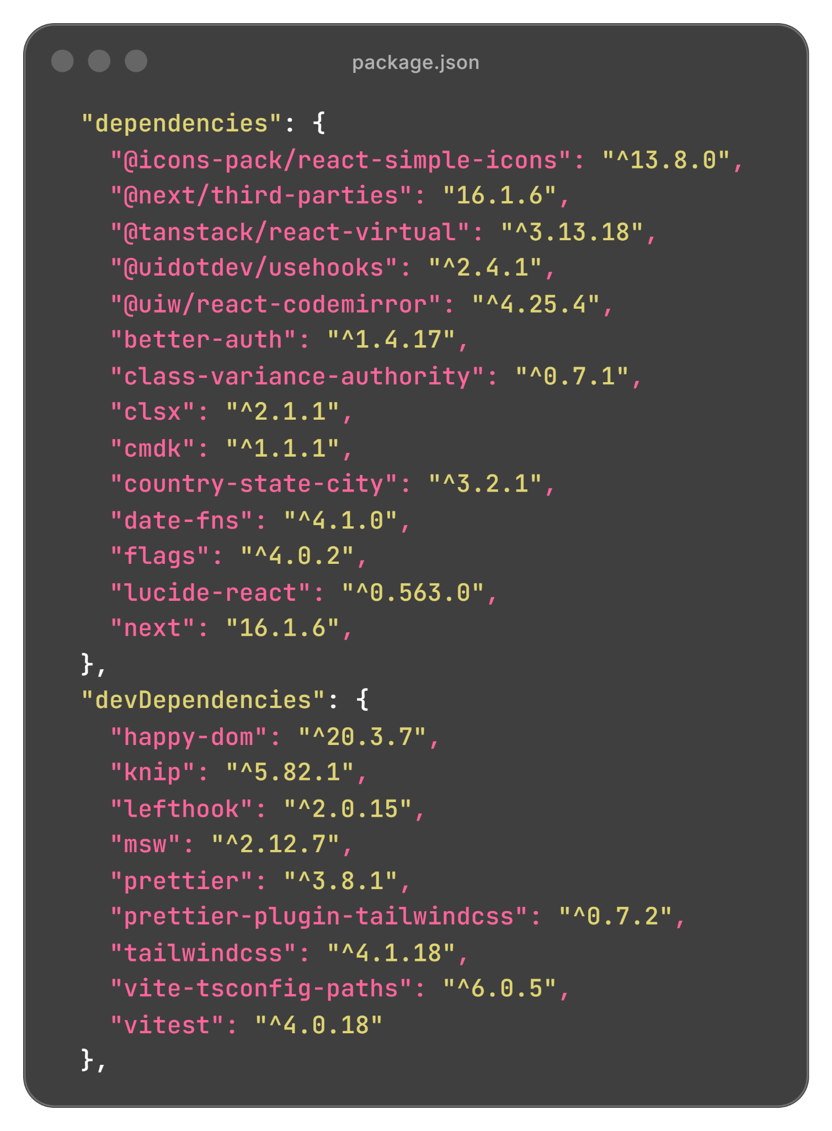
Packages written by strangers.
Packages you've never read.
Packages you trust completely.

Slide 6
The Real Story

Slide 7
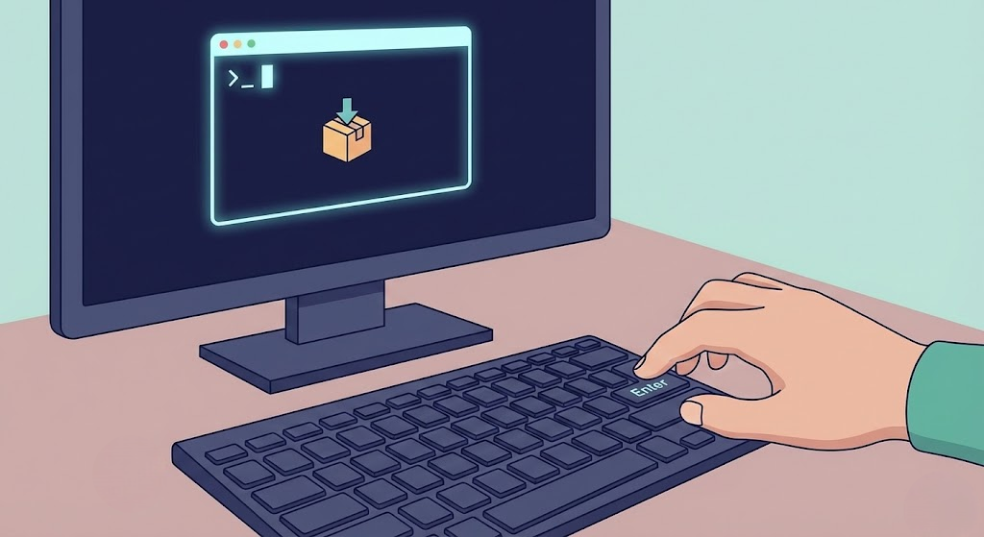
A developer (probably a lot like you) runs
npm install @ctrl/tinycolor-

Slide 8
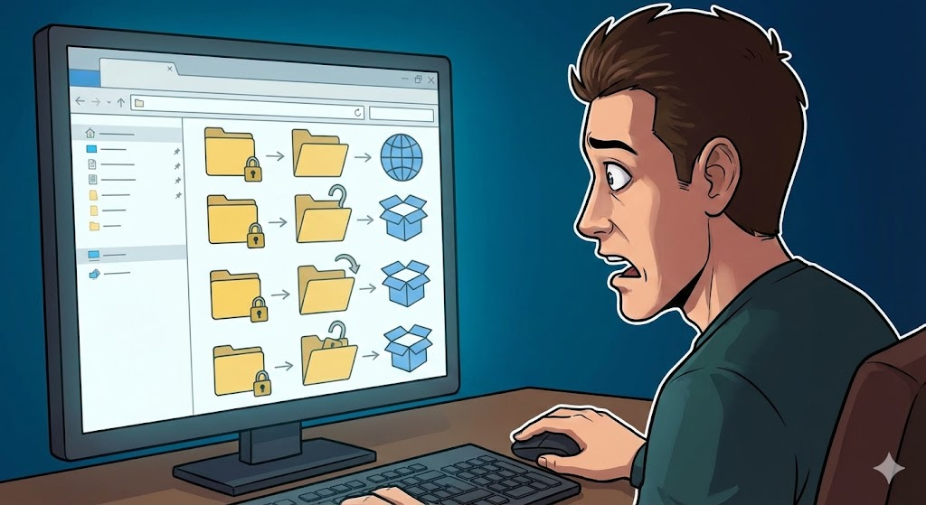
What happened in the next 3 minutes:
✅ AWS credentials stolen
✅ GitHub token exfiltrated
✅ npm token compromised
✅ 6 more packages infected automatically
✅ Private repos made public

Slide 9
This what exactly happened on Sept 2025
Shai Hulud Software Supply Chain Attack
safedep.io/npm-supply-chain-attack-targeting-maintainers/

Slide 10
Developer Mindset Vs Attacker Mindset
You think
Attackers Think
✅ I need colors in my terminal
✅ 10M downloads/week = safe
✅ Let me add this and move on
💡10M downloads = 10M potential victims
💡 Last update: 3 years ago = maintainer might be gone
💡 Simple package = easy to clone and typosquat
💡 Developer trust = my attack surface

Slide 11
Attacker's Playbook - Multiple Entry Points

Slide 12
The Dormant Package Hijack
☑️ Package hasn't been updated in 1+ years
☑️ Maintainer uses same email across npm/GitHub
☑️ Popular enough to spread (1K+ downloads/week)
☑️ No 2FA enforced on npm account

Slide 13
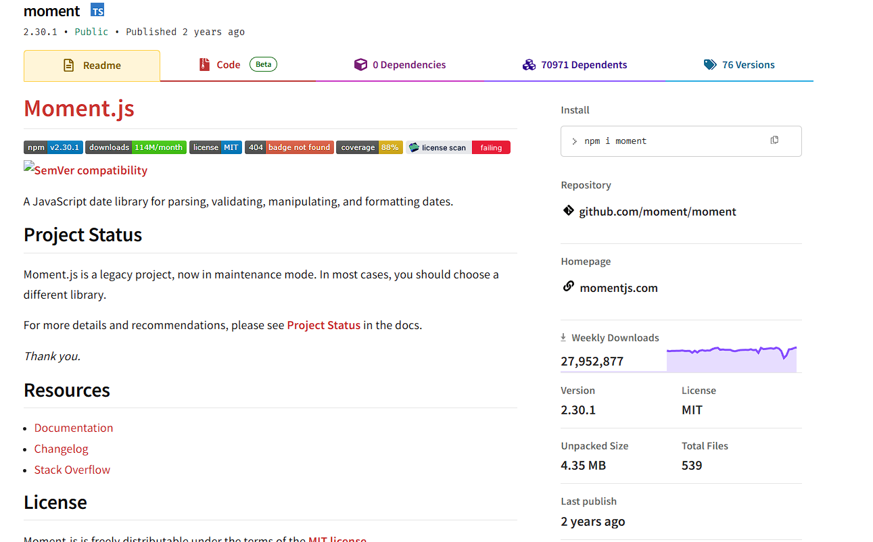
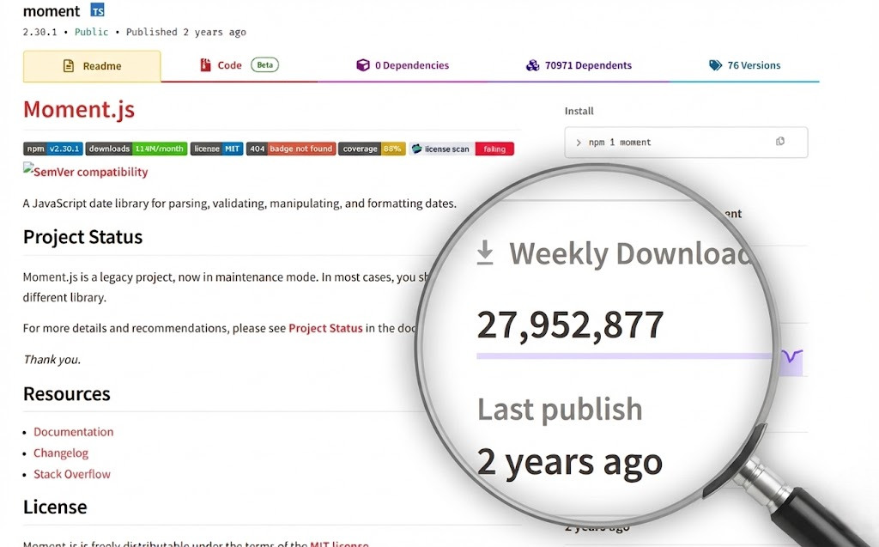

Slide 14
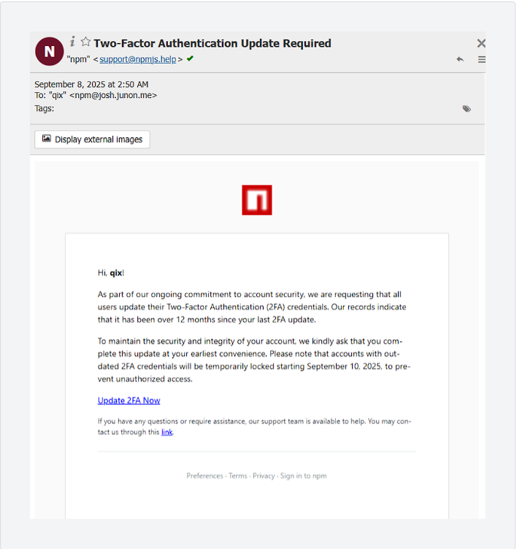
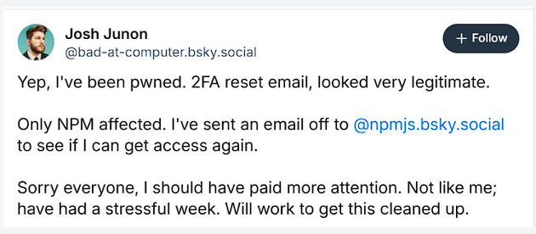
The Phishing Email

Slide 15
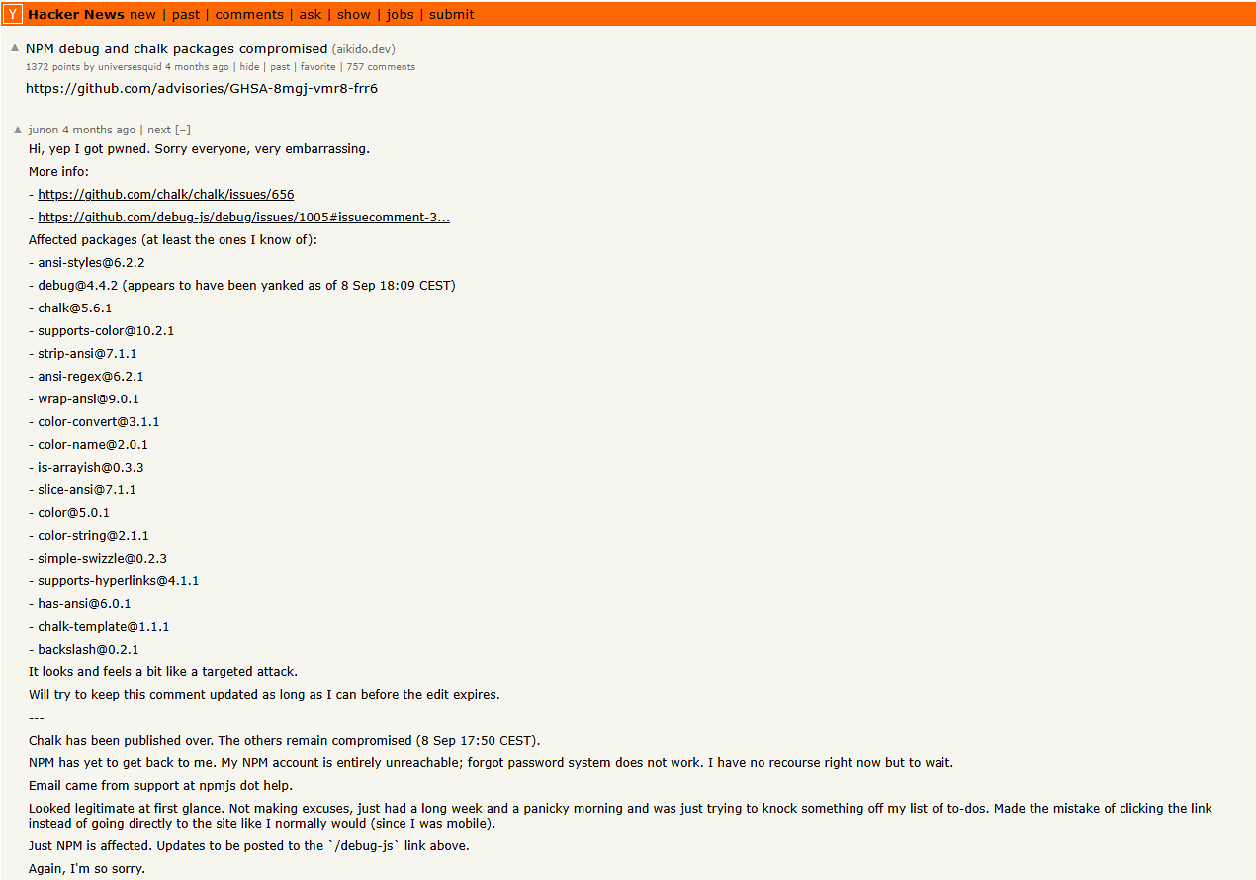
safedep.io/multiple-npm-packages-compromised-billion-downloads/

Slide 16
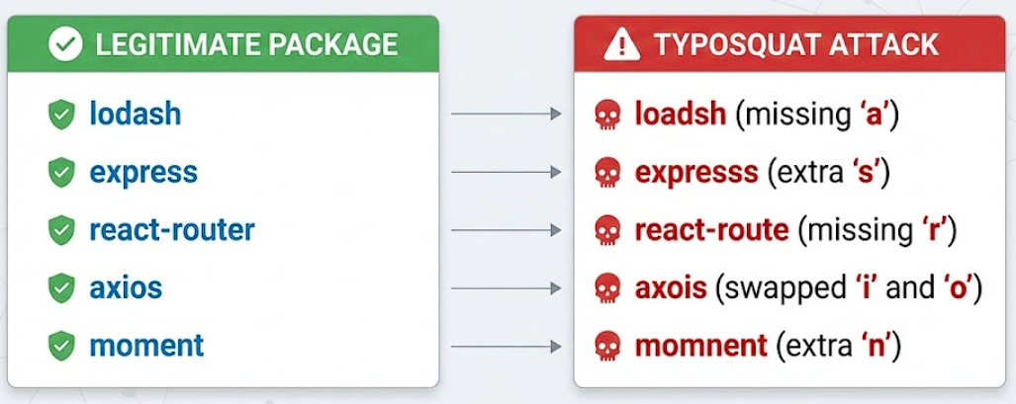
Typosquatting Trap

Slide 17
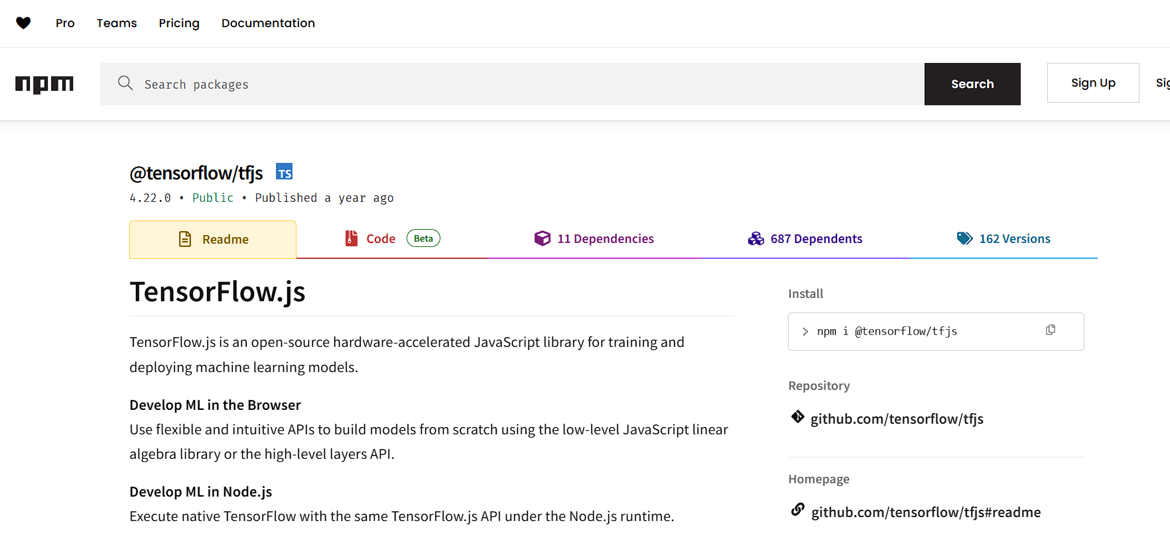
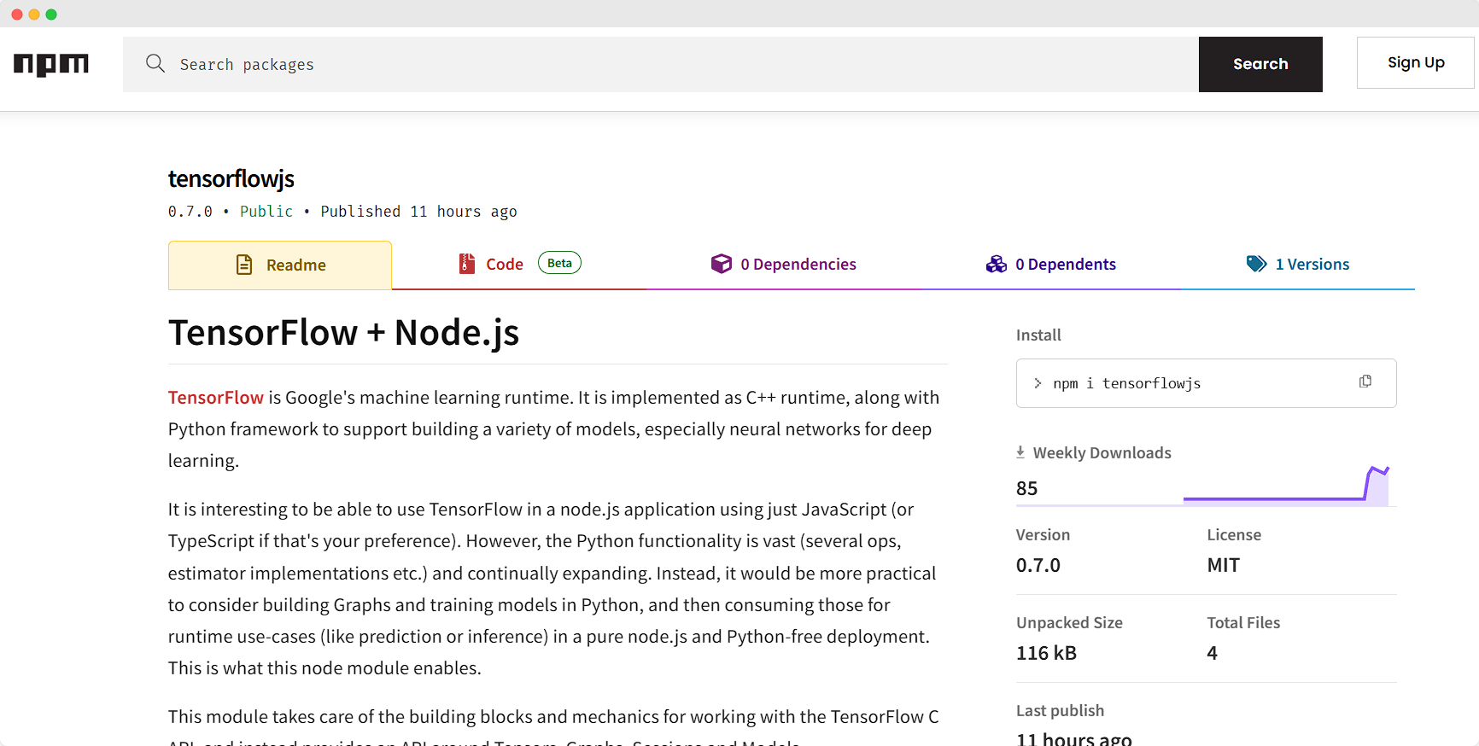
Real
Typosquatting

Slide 18
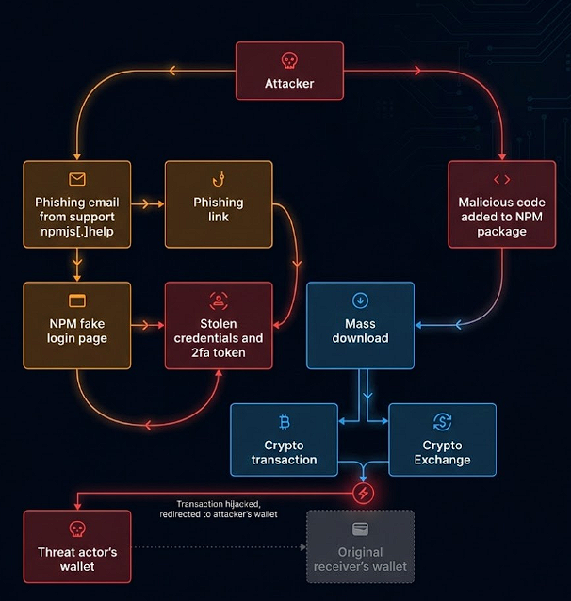
General attack flow

Slide 19
What about Vibe Coding - AI

Slide 20
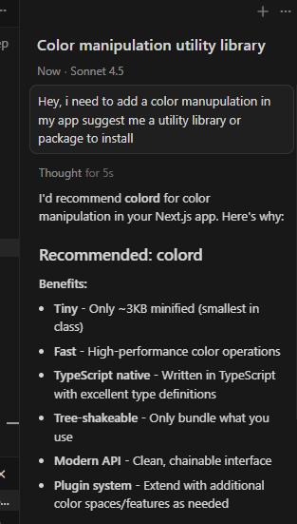
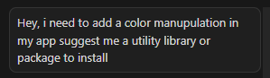
Result
Prompt

Slide 21
What AI knows
What AI doesn't know
❌ Package was compromised yesterday
❌ Any typosquat variant
❌ Maintainer's account was hacked
❌ malicious code in the latest version
✅ Package popularity (download stats)
✅ GitHub stars
✅ Documentation quality
✅ Code examples

Slide 22
AI is great for productivity
But could be terrible for security.

Slide 23
Let’s see how attackers think?

Slide 24
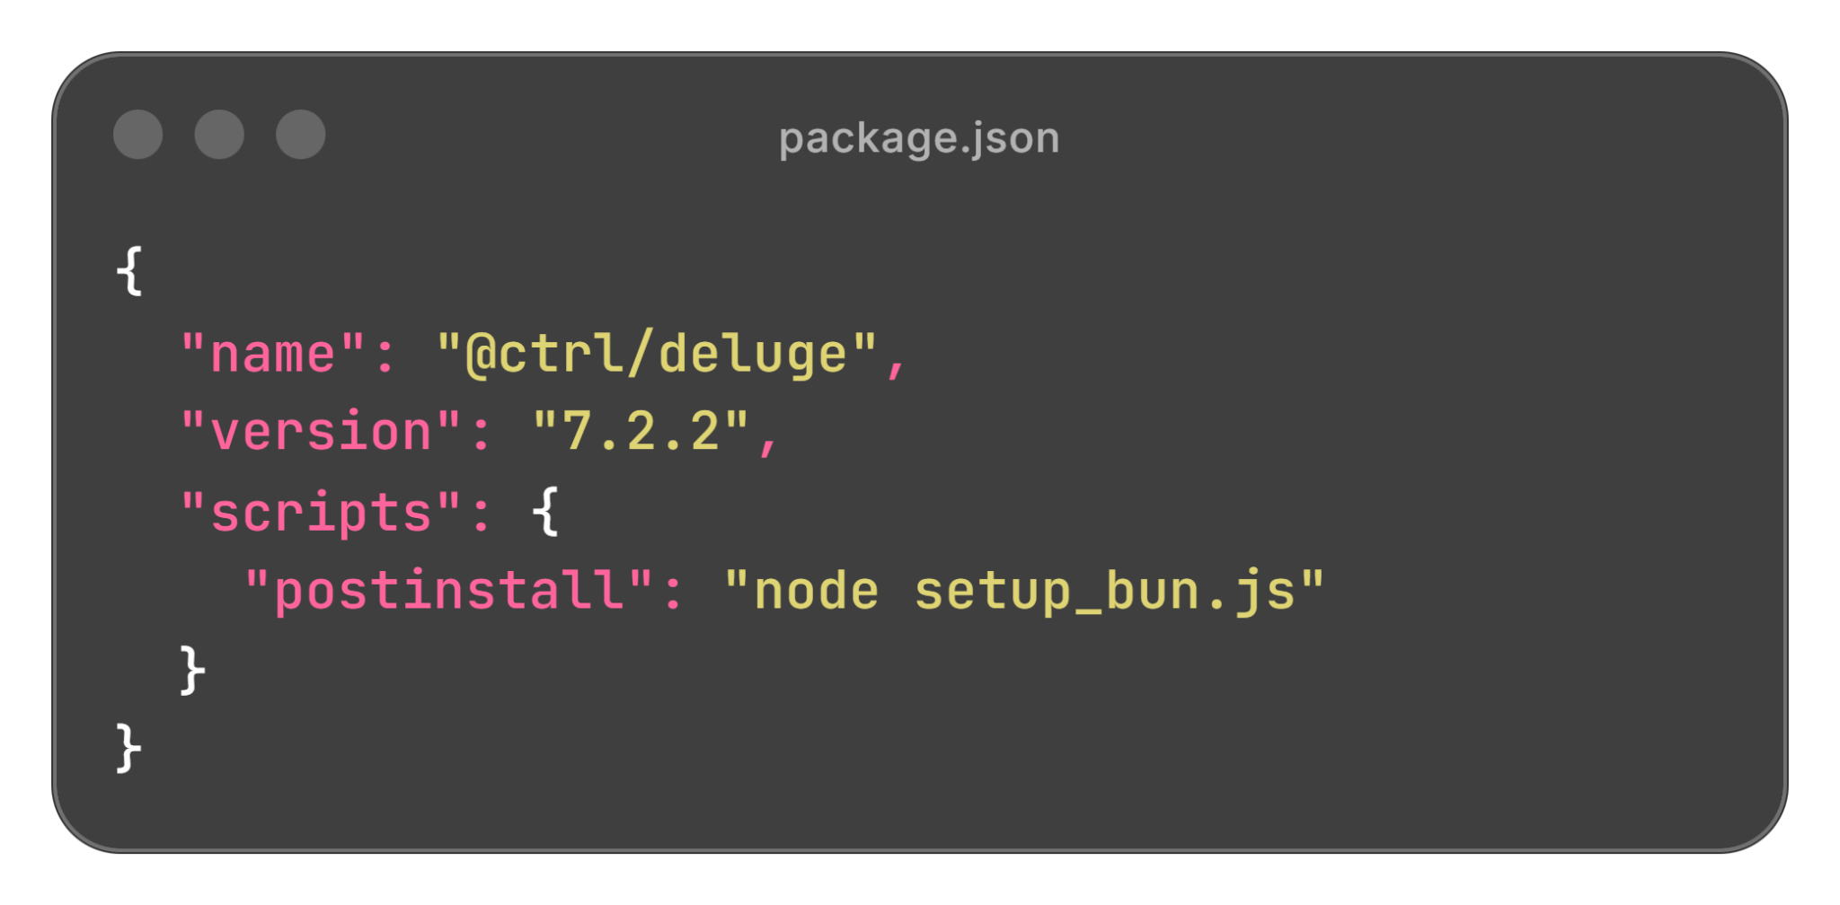
Shai-Hulud
@ctrl/deluge@7.2.2
Weapon

Slide 25
Let’s see the actual payload

Slide 26
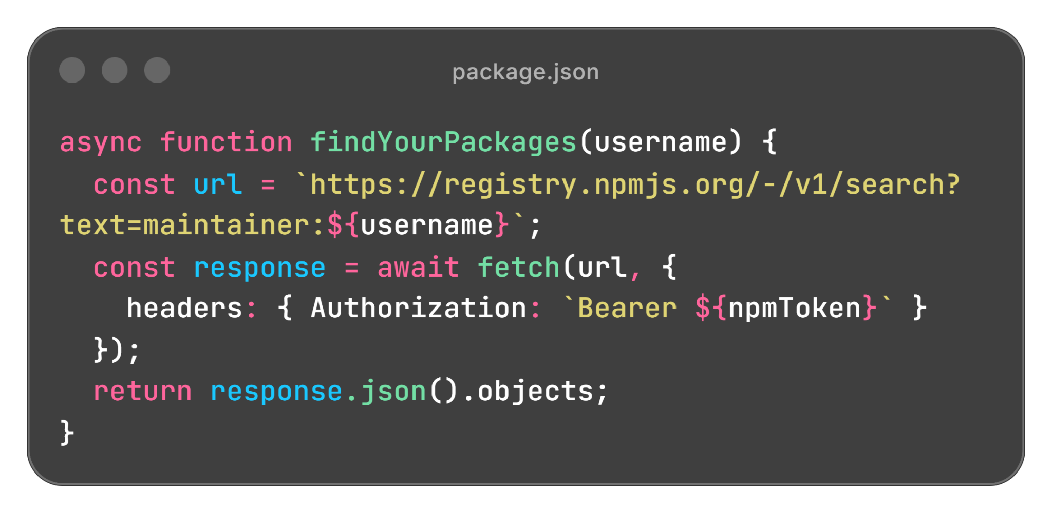
Read npm token from ~/.npmrc
Call npm API: "What packages does this user maintain?"
Get back a list of packages

Slide 27
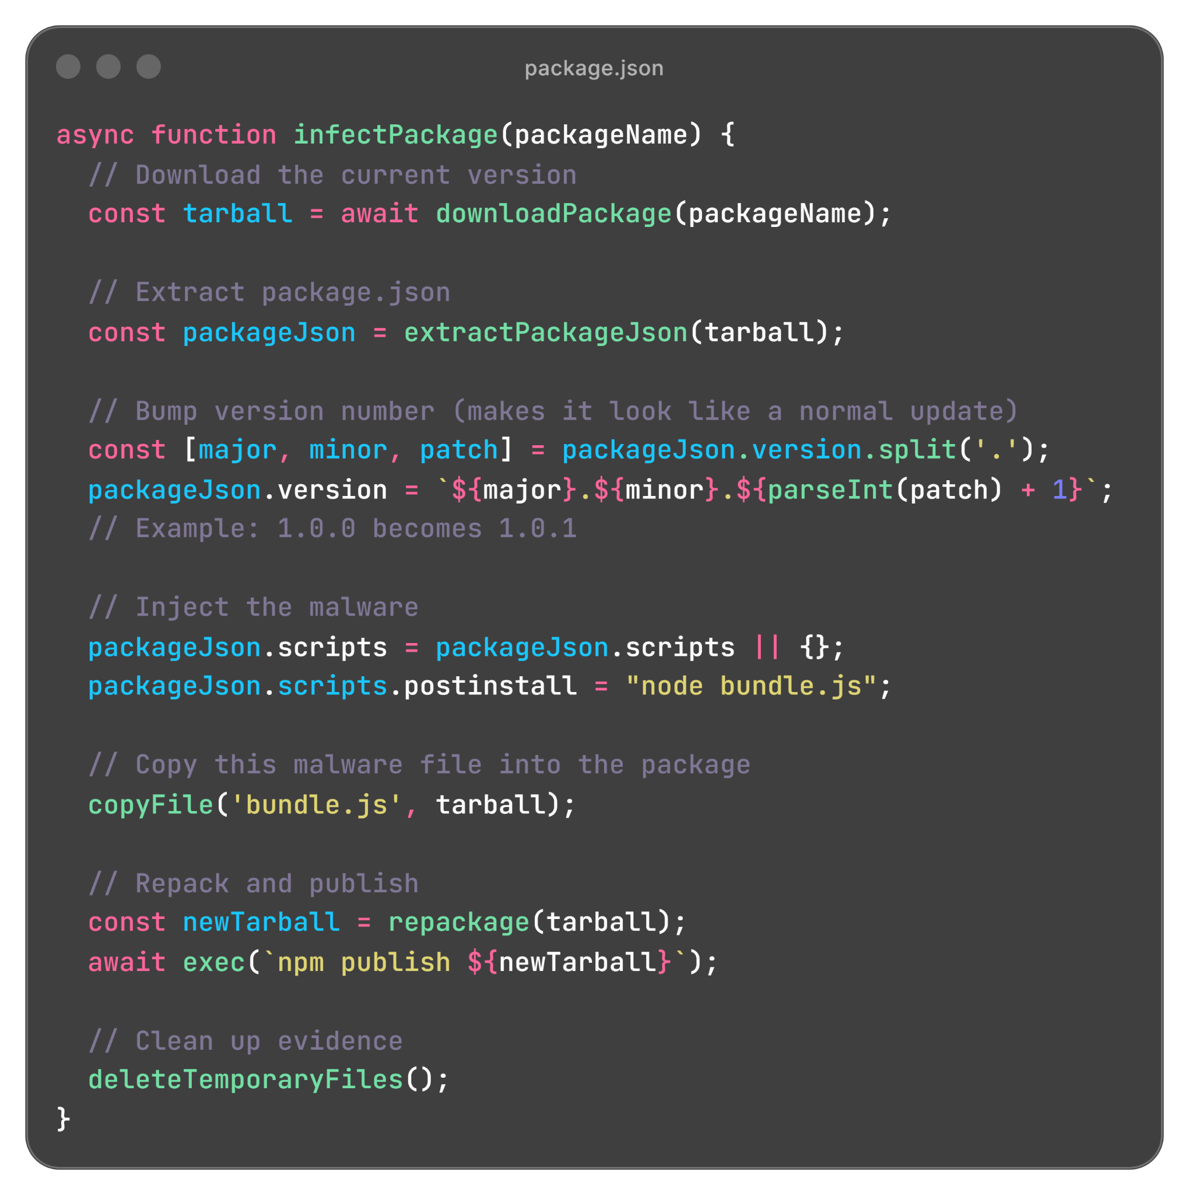
Download each package's current version
Extract package.json
Bump version: 1.0.0 → 1.0.1 (looks innocent!)
Add: "postinstall" : "node bundle.js"
Copy malware (bundle.js) into package
Repackage everything and run npm publish

Slide 28
Cycle continues…
New victims install the infected package
Spreads to THEIR packages
Worm runs on their machine
Worm behaviour

Slide 29
What was the impact?
500+ npm packages compromised
650+ repositories force-migrated to public
2,400+ GitHub tokens publicly leaked
$50 million in cryptocurrency stolen
AWS credentials, npm tokens were also got stoles

Slide 30
How to Not Get Owned.

Slide 31
🚩IMMEDIATE RED FLAGS (DO NOT INSTALL):
Brand new package with 0 GitHub stars
01.
No README or copy-pasted from another package
02.
Has postinstall/preinstall scripts you didn't expect
03.
Dormant package suddenly updated after 2+ years
04.
Obfuscated/minified code in what should be simple package
05.

Slide 32
How to protect yourself?

Slide 33
SafeDep is built on the belief that security tools should be free, transparent, and accessible to everyone!
Open Source First

Slide 34
Developers
CI/CD or Development
For Vibe Coders
SafeDep PMG
SafeDep vet
SafeDep MCP Server

Slide 35
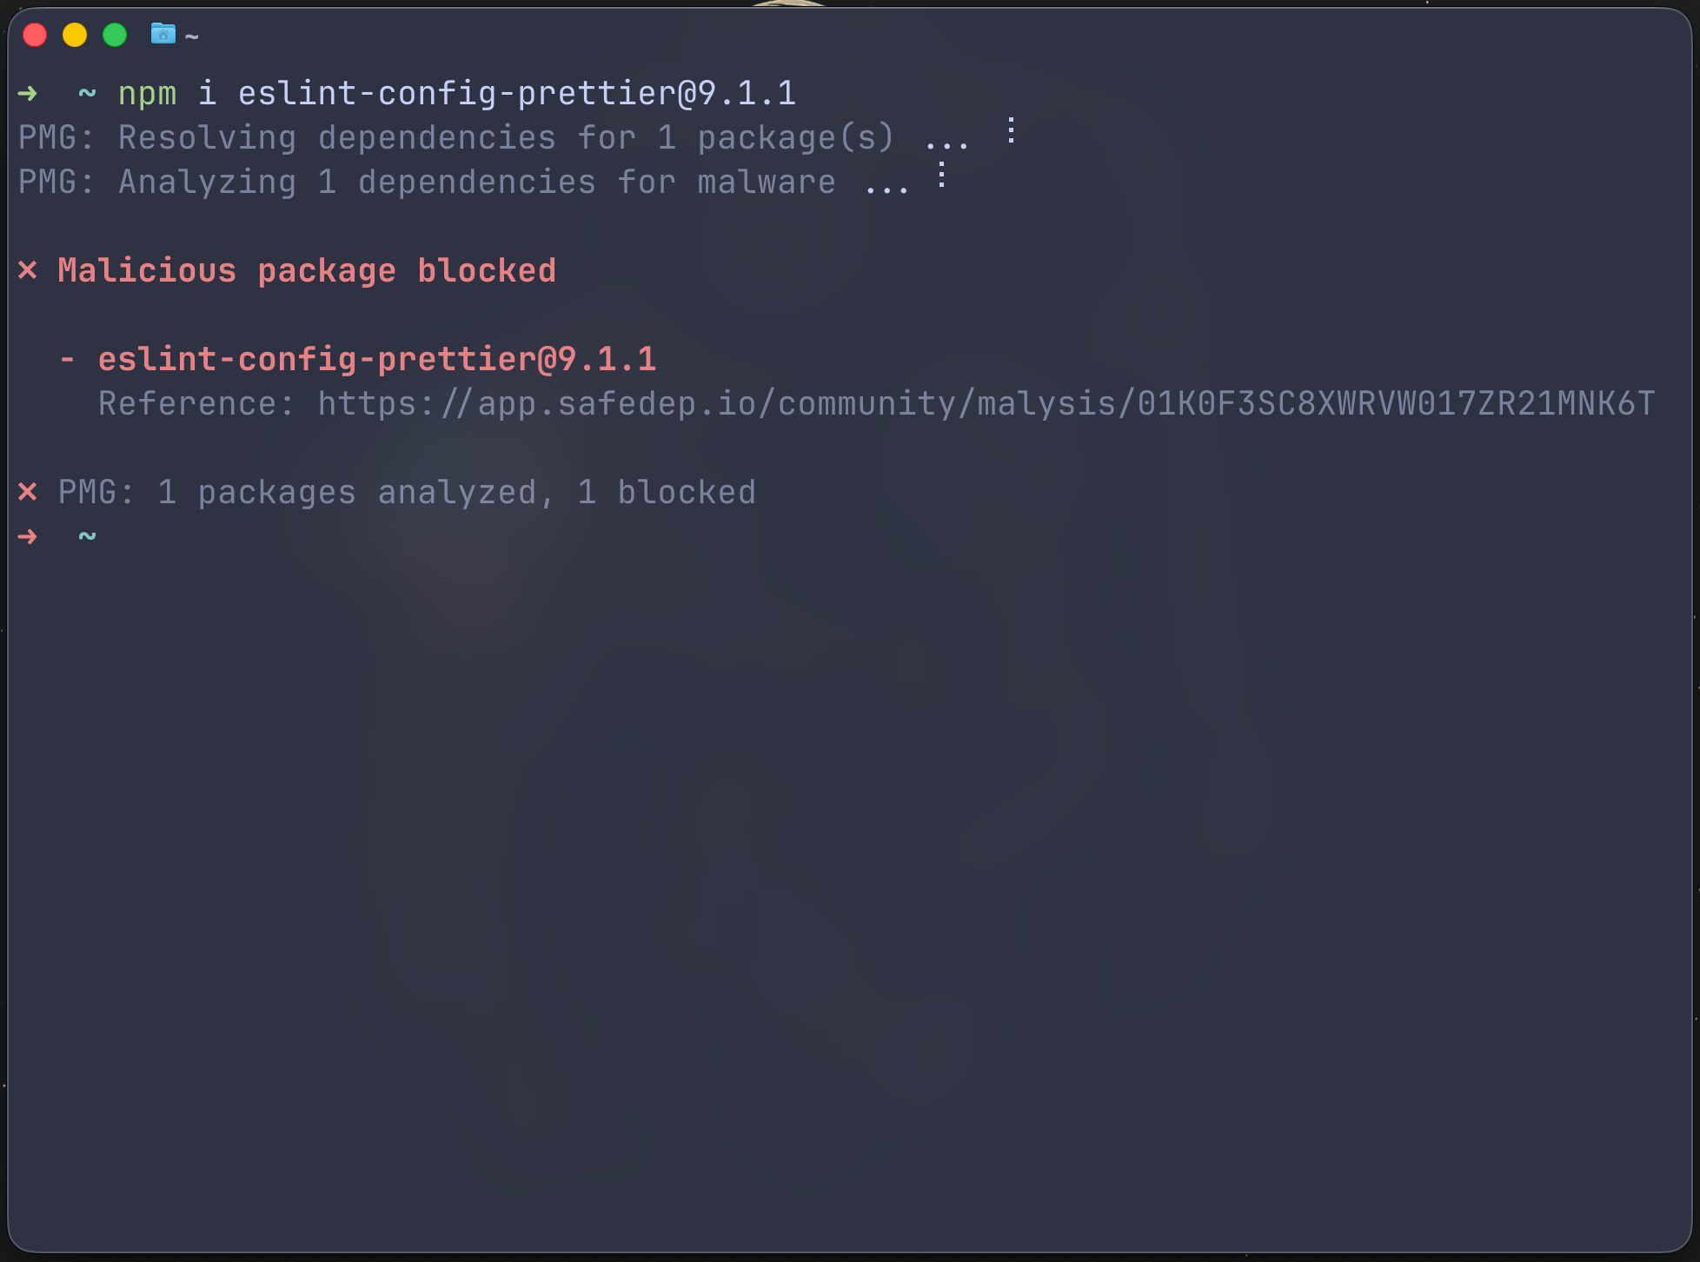
PMG
PMG (Package Manager Guard) protects developers from getting compromised by malicious packages during installation.
github.com/safedep/pmg

Slide 36
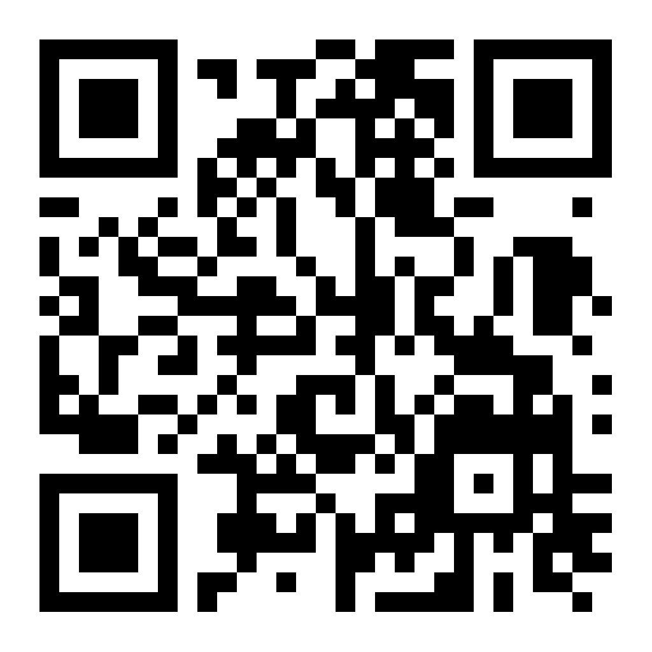
DEMO

Slide 37
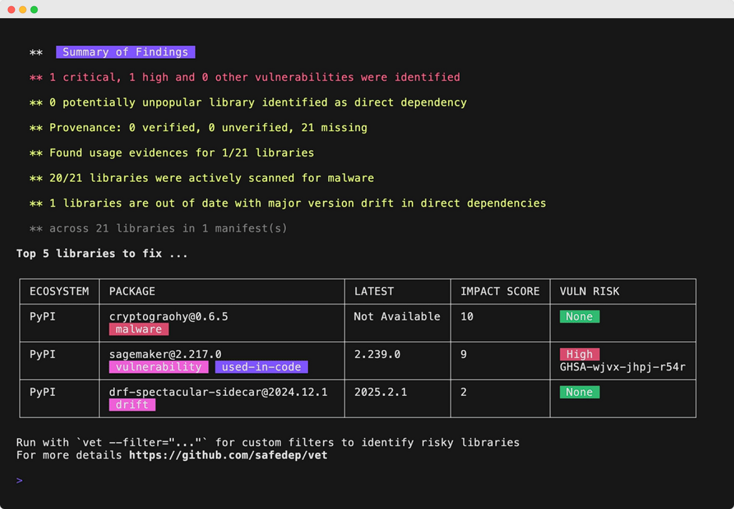
vet
SafeDep Vet is a free, open-source next-generation SCA tool that protects
against risky open-source components, including vulnerabilities and malware, across development, CI/CD, and production
github.com/safedep/vet

Slide 38
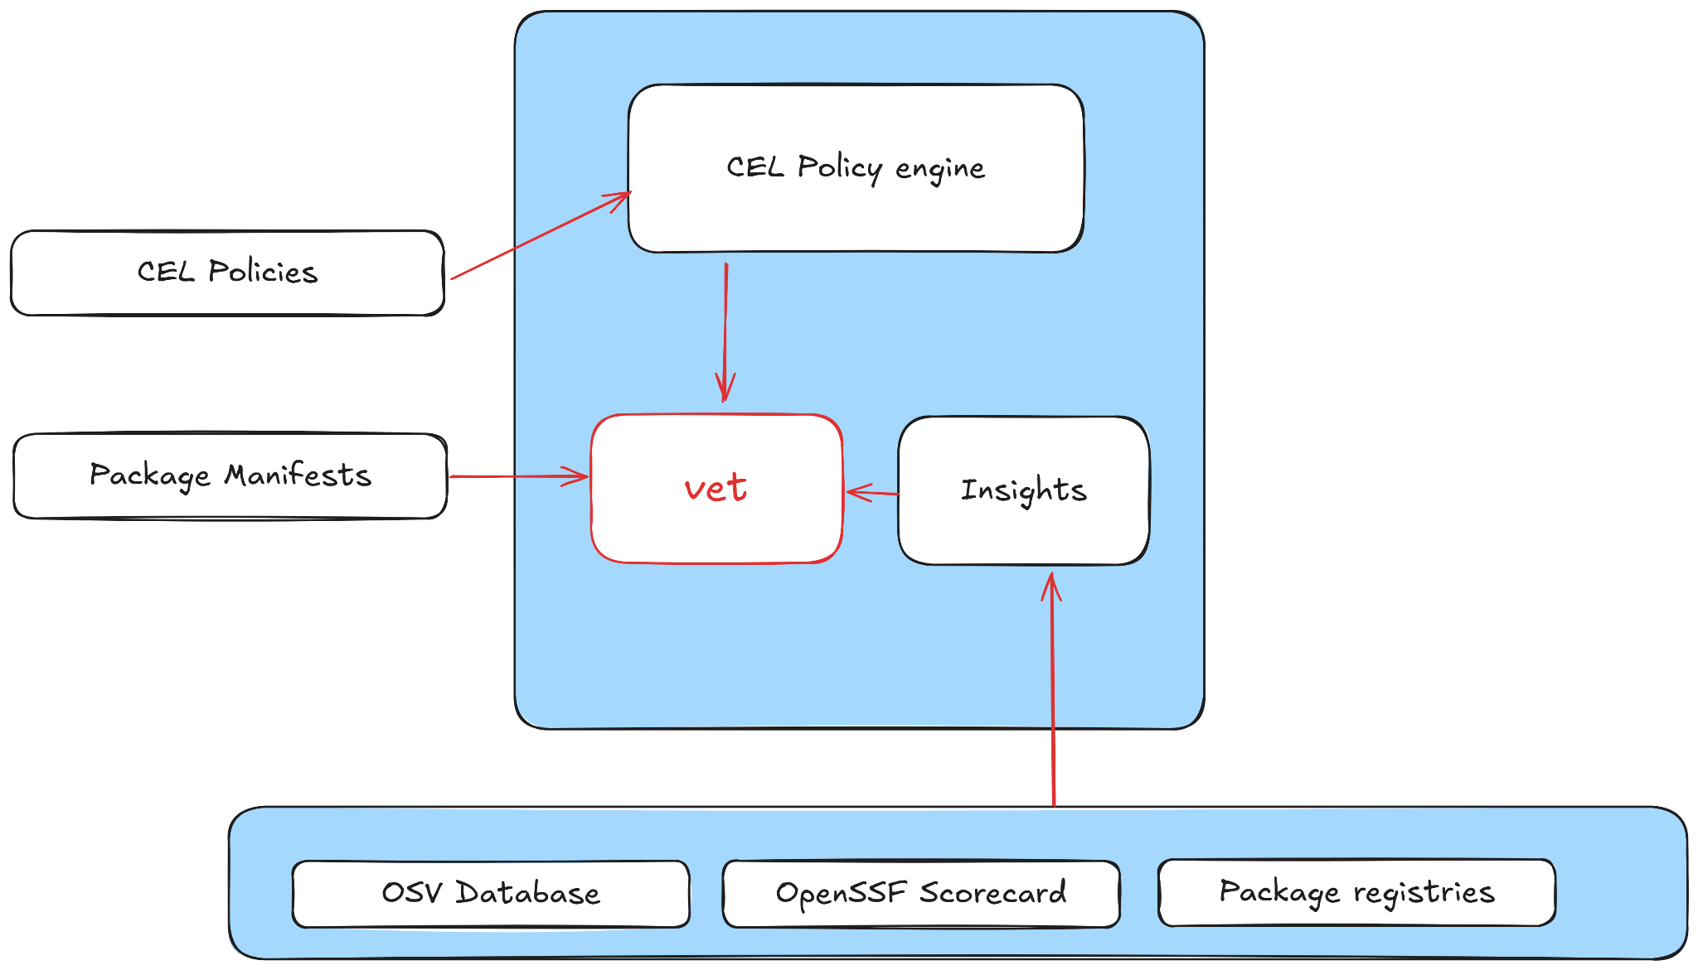
How vet works?

Slide 39
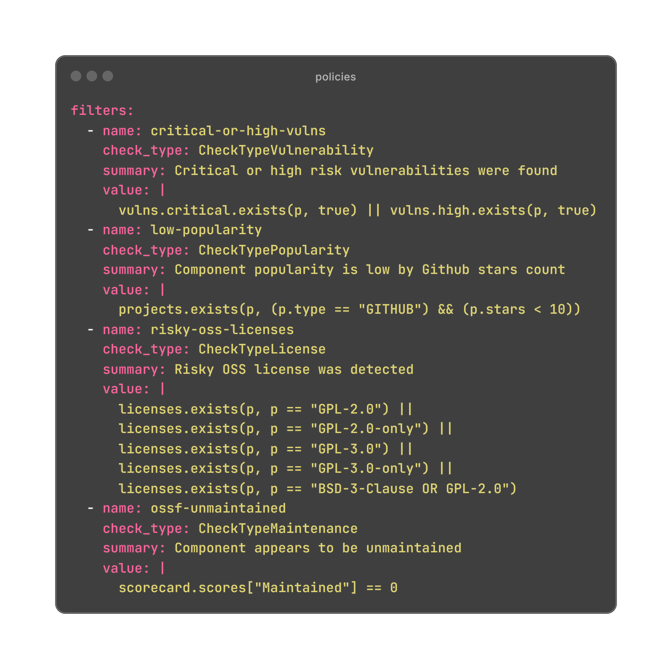
What are policies?
Policies are just CEL expressions to enforce context specific security requirements.

Slide 40
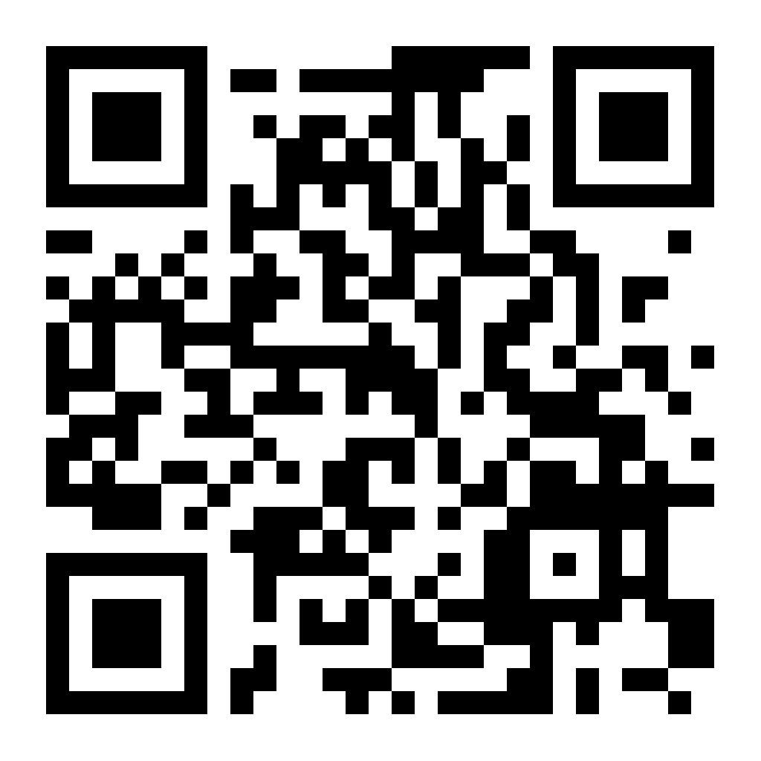
DEMO

Slide 41
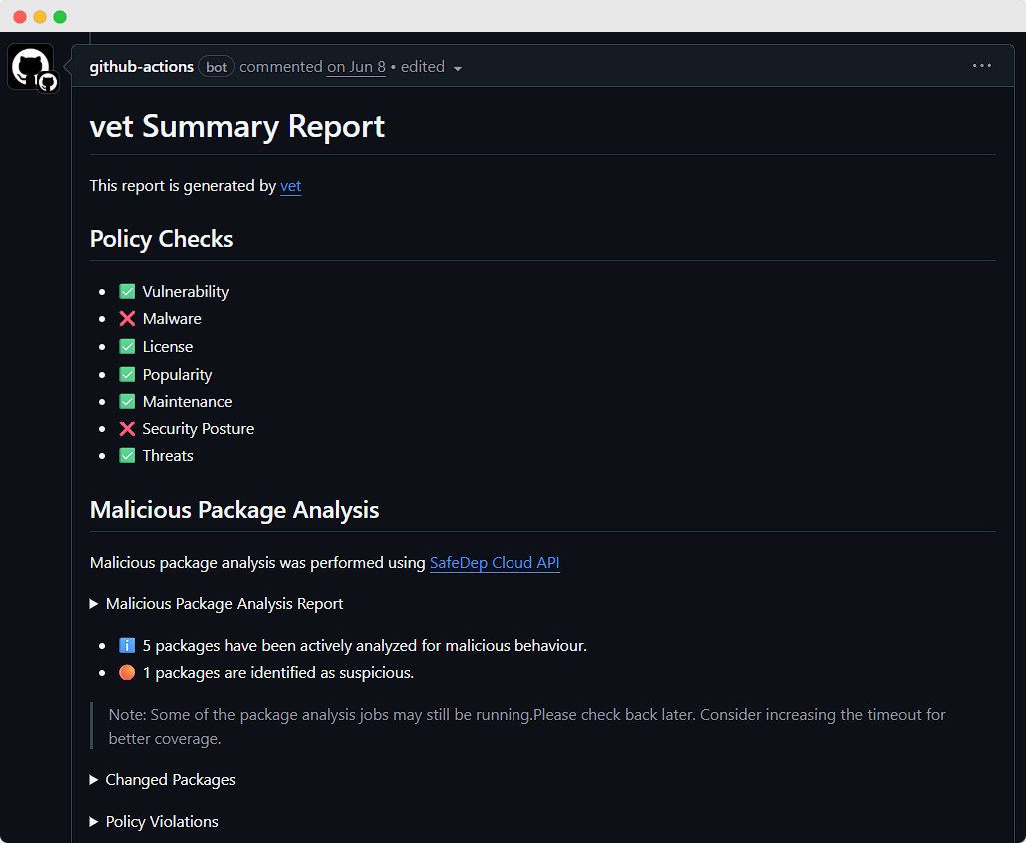
vet in CI/CD

Slide 42
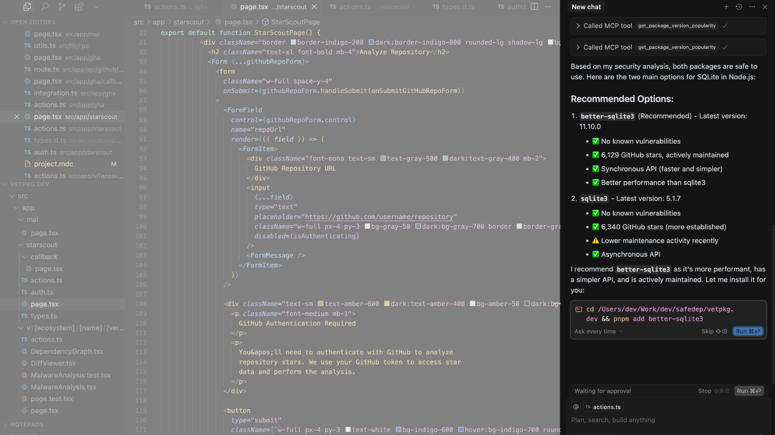
vet MCP Server

Slide 43
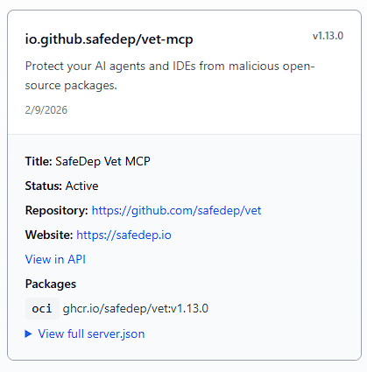
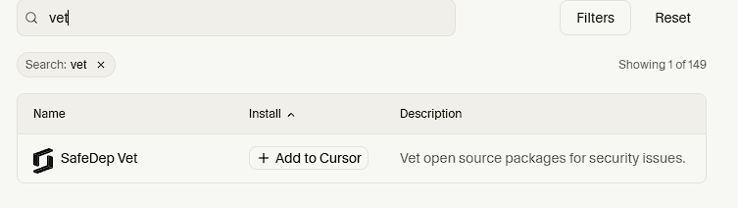
Official MCP Registry
Cursor - MCP Registry
MCP Directory | Cursor Docs
registry.modelcontextprotocol.io/?q=vet-mcp

Slide 44
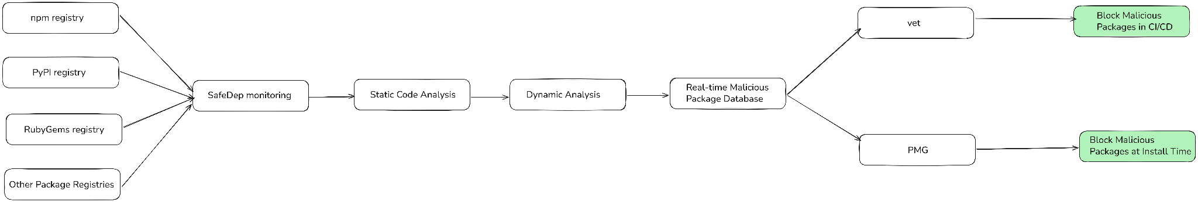
How SafeDep Works

Slide 45
Is This Paranoia Worth It?

Slide 46
Why hack a server when you can hack a developer?

Slide 47
Thank You

